Slide 1

EMBEDDED SYSTEMS — TASKS 1–4
Arduino-Based Car & Pedestrian Traffic Light System
A step-by-step implementation using Arduino Uno R3: from simple timed LED sequences to a state-driven, non-blocking pedestrian traffic controller.
Project Team & Presenters:
• Abu Sayem
• Jamsadul Bari Fahad
• Obed Aruho
Hochschule Hamm-Lippstadt (HSHL)

Slide 2
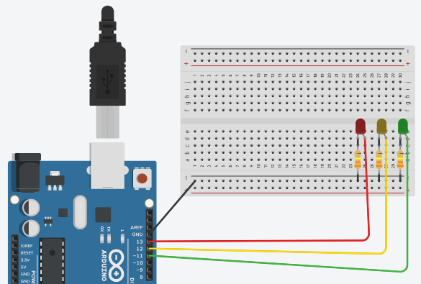
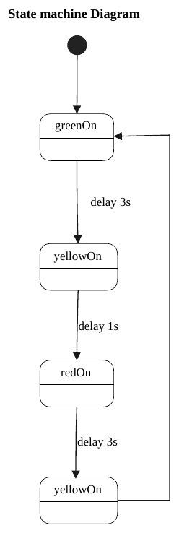
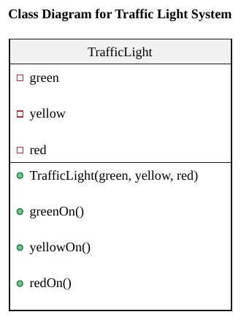
EMBEDDED SYSTEMS PROJECT
Task 1: Basic Car Traffic Light Circuit & Control
Hardware Components & Wiring:
• Arduino Uno R3 board + Breadboard
• 3 LEDs: Red (Pin 13), Yellow (Pin 12), Green (Pin 11)
• 3 Current-limiting resistors (330 Ω / 330 kΩ doc note)
• Common Ground (GND) connection
Software Object Structure:
• Class: TrafficLight
• Encapsulates Green, Yellow, Red pins
• Methods: greenOn(), yellowOn(), redOn()
• Keeps code organized and modular
Timing Cycle & Logic:
• Code Cycle: Green (10s) -> Yellow (5s) -> Red (10s) -> Yellow (5s)
• Total fixed loop time = 30 seconds
• State machine diagram shows standard repeating flow
• *Note: UML diagram delay labels (3s/1s) reflect theoretical concept.

Slide 3
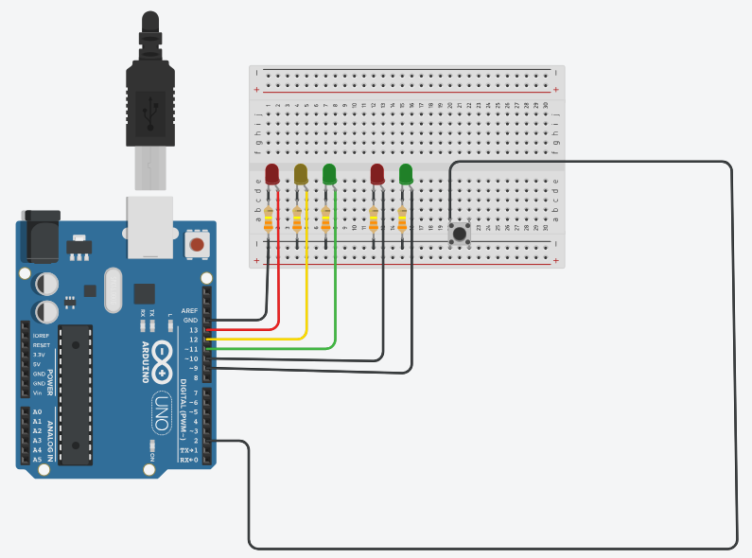
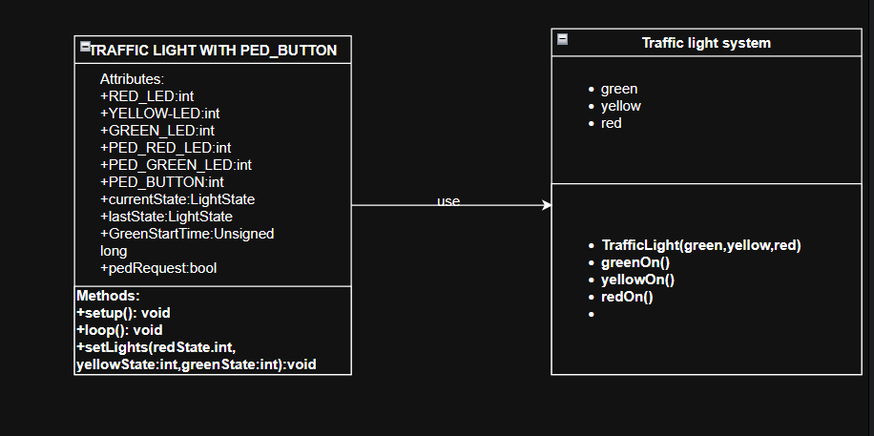
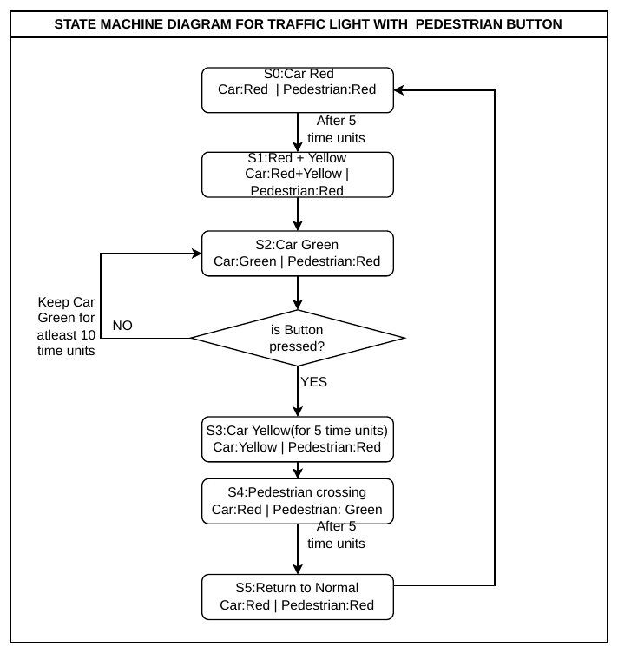
EMBEDDED SYSTEMS PROJECT
Task 2: Pedestrian Button Integration & Safety Buffer
Object Design & Request Handling:
• Class: TRAFFIC LIGHT WITH PED_BUTTON
• Tracks pedRequest boolean & GreenStartTime
• Button press registers request asynchronously
• Pedestrian light served only when safe during Red phase
Pedestrian Hardware Expansion:
• Push Button on Pin 2 (GND connection)
• Internal Pull-up resistor enabled (INPUT_PULLUP)
• Pedestrian Red LED: Pin 10
• Pedestrian Green LED: Pin 9
• Car LEDs stay on Pins 11, 12, 13
Safety Buffer & State Sequence:
• Enforces 2-second All-Red safety buffer before Walk
• Enforces 2-second All-Red safety buffer after Walk
• Prevents sudden light switches while cars are moving
• Ensures pedestrians cross safely while Car Red is active

Slide 4
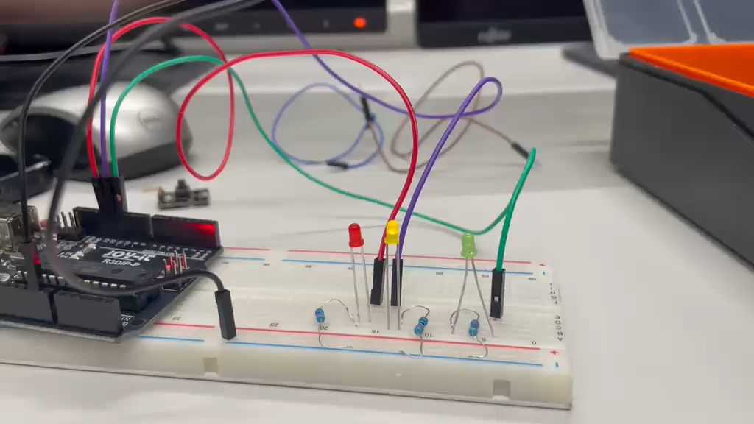
EMBEDDED SYSTEMS PROJECT
Task 3: Non-Blocking Timing & Simulation
Key Improvements & Logic Shift:
1. Transition from delay() to millis():
• Blocking delay() prevents microcontroller from reading button inputs instantly.
• millis() measures elapsed time continuously without stopping processor execution.
2. State Machine Implementation (switch-case):
• Organizes system into 4 explicit car states (Green, Yellow, Red, Yellow).
• non-blocking timers track state duration independently.
3. Hardware Pin Mapping (Same as Task 1):
• Car Green: Pin 11 | Car Yellow: Pin 12 | Car Red: Pin 13
• Timing: Green 10s, Yellow 5s, Red 10s, Yellow 5s (Total 30s cycle)
4. Simulation Verification:
• Tested and validated in circuit simulation before physical breadboard setup.

Slide 5
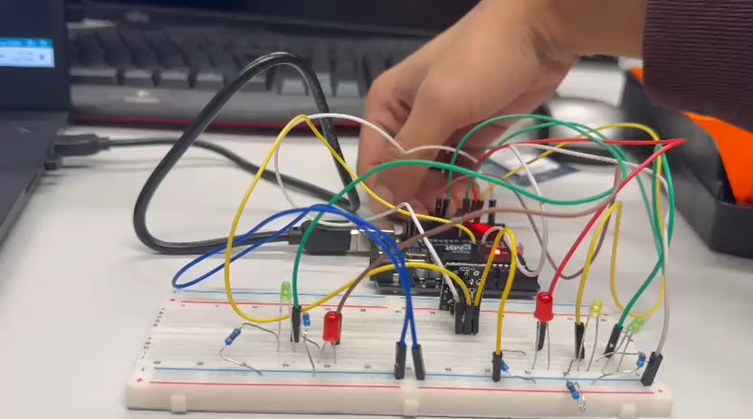
EMBEDDED SYSTEMS PROJECT
Task 4: Final Integrated Car & Pedestrian System
Final Integrated Features & Reassigned Pins:
1. Updated Hardware Pin Mapping (Task 4 Code):
• Car Green: Pin 7 | Car Yellow: Pin 5 | Car Red: Pin 6
• Pedestrian Green: Pin 11 | Pedestrian Red: Pin 12
• Pedestrian Button: Pin 2 (INPUT_PULLUP)
2. Non-Blocking Logic + Request Flag:
• Pressing button sets pedRequest = true instantly without stopping car timers.
3. Programmed Timings (Code Constants):
• Car Green / Red duration: 5,000 ms (5 s)
• Car Yellow duration: 2,000 ms (2 s)
• Pedestrian crossing safety buffer: 2,000 ms (2 s)
4. Complete Safety Flow:
• Car Red active -> 2s Buffer -> Ped Green ON -> 2s Buffer -> Resume Car Green

